Slide 1


Slide 2
Presented by:
Eisha Asim (243575)
Rasba Mazhar (243571)
Saleha Khurram (243529)
Laiba Shahzad (243539)
Abeera Shahid (243589)

Slide 3
Job Application Letter: A Comprehensive Guide

Slide 4

Job Application Letter
Today, we'll delve into the essential components of a successful job application, from crafting compelling paragraphs to understanding the structure and etiquette of this crucial document. We'll explore each aspect in detail, ensuring you are well-equipped to impress potential employers and secure your dream job.

Slide 5
Definition of a Job Application
A job application is a formal document that expresses your interest in a specific position at a company. It typically consists of two key parts: a resume summarizing your professional background and a cover letter outlining your qualifications and motivations.
This comprehensive package serves as your introduction to a prospective employer, showcasing your skills, experiences, and eagerness to contribute to the company's success.

Slide 6

Why Job Applications Matter?
First Impression
Your job application often serves as the initial point of contact with a potential employer. It provides your first impression, highlighting your professionalism, communication skills, and suitability for the role.
Filtering Candidate
Companies receive numerous applications for every position. A well-structured and compelling application can help you stand out from the crowd and increase your chances of being selected for an interview.
Demonstrating Interest
A job application showcases your genuine interest in the company and its specific position. By taking the time to craft a thoughtful application, you convey your dedication and enthusiasm.

Slide 7



Key Components of a Job Application
Resume
A chronological summary of your professional background, including education, work experience, skills, and achievements. This document outlines your career journey and highlights your qualifications
Cover Letter
A personalized letter addressing a specific job opportunity. This letter explains your interest in the position, highlights relevant skills, and outlines your contributions to the company.

Slide 8
Address, Salutation, and Paragraphs
Paragraphs
The body of the letter comprises multiple paragraphs that detail your qualifications, interest in the position, and contributions to the company. Each paragraph should focus on a specific theme or aspect of your candidacy.
Salutation
The salutation, or greeting, is a formal address to the recipient. Use "Dear [Hiring Manager's name]" if you know the name or "Dear Hiring Manager" if the name is unavailable
Address
The address of the recipient, typically the hiring manager or the company's human resources department, is placed at the top left of the letter. Use a formal and professional tone.

Slide 9
Crafting Compelling Paragraphs
Introductory Paragraph
Begin by expressing your enthusiasm for the position and your familiarity with the company. Briefly highlight relevant skills and experiences that align with the job requirements.
Educational Paragraph
Showcase your academic background, highlighting your relevant degrees, coursework, and achievements that demonstrate your expertise and knowledge in the field.
Employment Paragraph
Describe your previous work experience, focusing on specific accomplishments, skills, and responsibilities that demonstrate your capabilities and value to the company.
Conclusion Paragraph
Reiterate your interest in the position and express your eagerness to contribute to the company's success. Thank the recipient for their time and consideration.

Slide 10
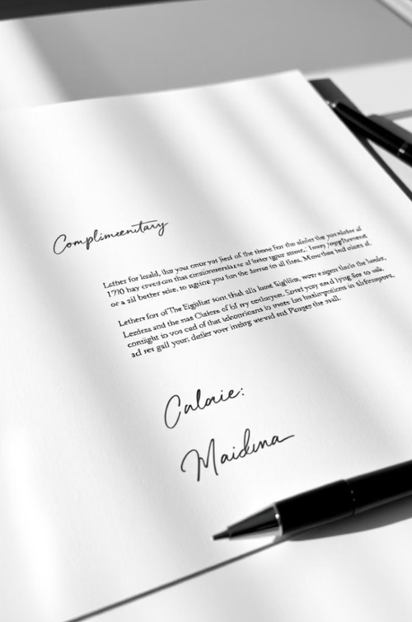
Complementary Close and Signature
Complementary Close
The complementary close is a formal ending phrase, such as "Sincerely," "Respectfully," or "Best regards." This phrase expresses gratitude for the opportunity.
Signature
Your handwritten signature goes below the complementary close. This adds a personal touch and demonstrates your professionalism. Type your full name underneath the signature for clarity.

Slide 11
Enclosure and Additional Details
Enclosure
If you are including any additional documents, such as a resume or portfolio, mention "Enclosure" and list the documents. This helps the recipient know what to expect.
Additional Details
You may include any relevant details, such as your contact information, availability, or specific skills you wish to emphasize. Make sure this information is accurate and up-to-date

Slide 12
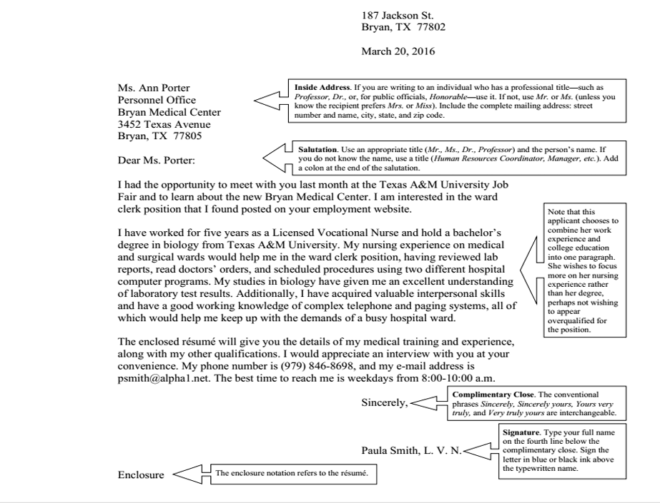
Sample Job application Writing

Slide 13

Conclusion and Next Steps
1
Proofread Carefully
Before submitting your application, proofread your work thoroughly. Ensure your writing is free of errors in grammar, spelling, and punctuation.
2
Tailor for Each Position
Each job application should be tailored to the specific requirements of the position. Highlight relevant skills and experiences that align with the company's needs
3
Follow Up
After submitting your application, follow up with the employer to express your continued interest. Thank them for their time and consideration.

Slide 14
CV/ Résumé Writing: Crafting Your Path to Success
"Presenting Your Best Professional Self"

Slide 15
What is Résumé?
A résumé is a professional document that summarizes an individual’s education, training, experience, skills, achievements, and references. Its primary purpose is to secure a job interview by showcasing the applicant’s suitability for a specific position. Writing an effective résumé can be challenging, as it must represent current skills and background while being tailored to the job. A well-crafted résumé grabs the employer’s attention and should be as persuasive as possible.

Slide 16
Difference between CV and Résumé
Features | CV (Curriculum Vitae) | Résumé
Length | 2+ pages (detailed) | 1-2 pages (brief)
Purpose | Detailed overview of academic and professional history | Focused summary for a specific job
Content | Includes education, work history, research, publications, certifications, etc. | Highlights relevant work experience, skills, and education
Customization | Rarely customized, serves as a comprehensive career record | Highly tailored to the job description
Use | Common in academia, research, and international roles | Common in most job applications

Slide 17
Types of Résumé
Chronological: Focuses on your work experience, listed from the most recent job to the oldest.
Functional: Highlights your skills and achievements rather than focusing on the timeline of your work history.
Combination: Combines both your skills and work history, offering a well-rounded view of your qualifications.
Targeted: Specifically tailored to fit the requirements of a particular job or industry, emphasizing relevant skills and experiences.

Slide 18
Importance of Résumé
A Résumé is essential for effective communication,showcasing your qualifications and skills.
It creates a first impression and helps you stand out among other applicants.
A well-crafted resume is key to being shortlisted for an interview.
It acts as a persuasive tool, highlighting why you’re the right fit for the job.
Writing a strong resume is crucial in the job search process to get noticed and land the job.

Slide 19
Key Points of Résumé :
Contact Information
Objective
Work Experience
Education
Additional sections (certificates,languages etc)
References
Skills

Slide 20
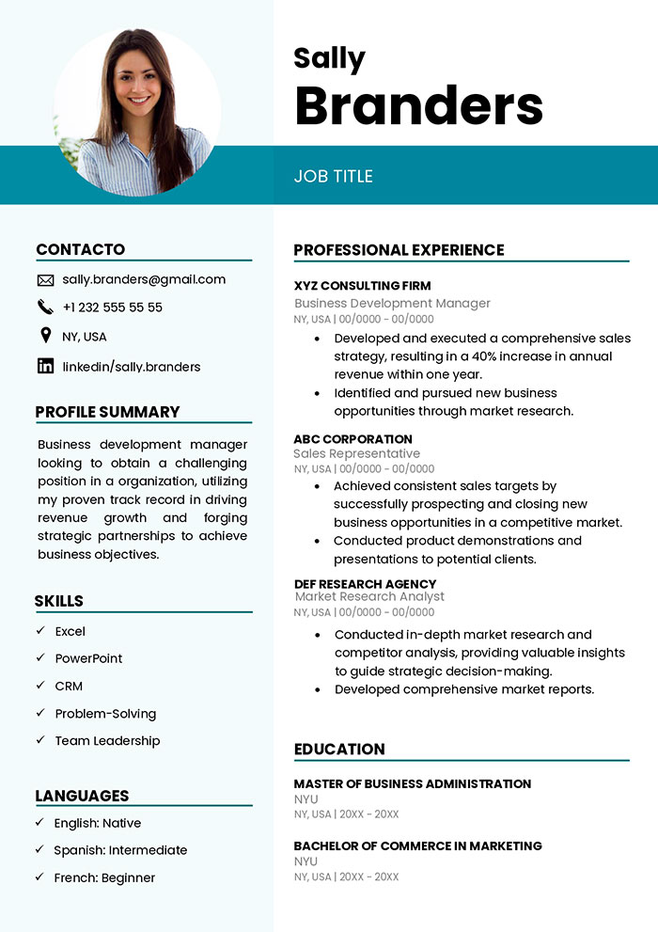
Contact Information
Contact Information is crucial for employers to reach you and should be placed at the top of your resume. Include:
Full Name
Professional Email
Phone Number
LinkedIn/Profile (if relevant)
Avoid personal details like age, gender, or a photo unless requested, to prevent bias or privacy issues. Keep this section simple, professional, and easy to find.

Slide 21
Professional Summary / Objective Statement
A Professional Summary or Objective is a brief statement at the beginning of your résumé that highlights your career goals, key skills, and qualifications. Here's the difference:
Professional Summary:
A few sentences summarizing your experience, skills, and accomplishments, typically for experienced professionals. It showcases what you bring to the job and your value.
Objective:
A statement of your career goals and what you aim to achieve in the position you're applying for. This is more common for entry-level positions or those making a career change.
Both should be clear, concise, and tailored to the specific job you're applying for.

Slide 22
Key Skills Section
The Key Skills section of a résumé highlights your most relevant abilities for the job you're applying for. It provides a quick overview of your expertise, allowing employers to quickly see if you have the skills they need.
Here’s what to include:
Relevant Skills: List specific skills related to the job, such as technical abilities, software knowledge, or communication skills.
Soft Skills: Include traits like teamwork, problem-solving, and leadership if they are important for the role.
Tailored to the Job: Customize this section for each job application, focusing on the skills most relevant to the position.
Keep it concise, with a bullet-point list for easy scanning.

Slide 23
Importance of Work Experience
This section of the résumé must provide a clear overview of the applicant's work experience, which is vital for hiring decisions. Prioritize relevant experience before education. List work experience in reverse chronological order, starting with the most recent position. Include the job title, employer's name, location (town, state), dates of employment, and key responsibilities or accomplishments. Highlight capabilities and positive traits such as motivation, eagerness to learn, confidence, and strong communication skills to effectively showcase qualifications.

Slide 24
Essential Components to Incorporate in the Education Section.
Degree and Major
State your highest degree earned, your major, and your minor, if applicable. You can also include your expected graduation date if you are still in school.
University or College
Include the name of the institution, including its location. You can also add the school's reputation or accolades, especially if they are relevant to the job.
GPA (Optional)
Only list your GPA if it is above a 3.0 or if the job description specifically asks for it. If it's below, you can omit it to avoid raising any red flags.

Slide 25
Enhanced Components for Your Résumé
Certifications: Include industry-specific certifications.
Example: Google Analytics Certification, AWS Solutions Architect.
Volunteer Work: Demonstrates initiative and leadership.
Example: "Organized community outreach programs, increasing local engagement by 25%."
Languages: Indicate fluency levels (e.g., Fluent, Intermediate).
Example: "Fluent in Spanish, Intermediate in French."
Projects: Highlight relevant projects showcasing skills.
Example: "Developed an e-commerce website that increased client sales by 40%."

Slide 26
What to Include in the Reference Part?
Contact Information
Provide the full name, job title, company, email address, and phone number of each reference
Relationship to You
Briefly describe the nature of your relationship with each reference, such as supervisor, colleague, or professor.
Date of Employment
Include the dates of your employment or engagement with each reference, if applicable.
John Smith Manager, ABC Corporation Phone: (123) 456-7890 Email: john.smith@example.com

Slide 27
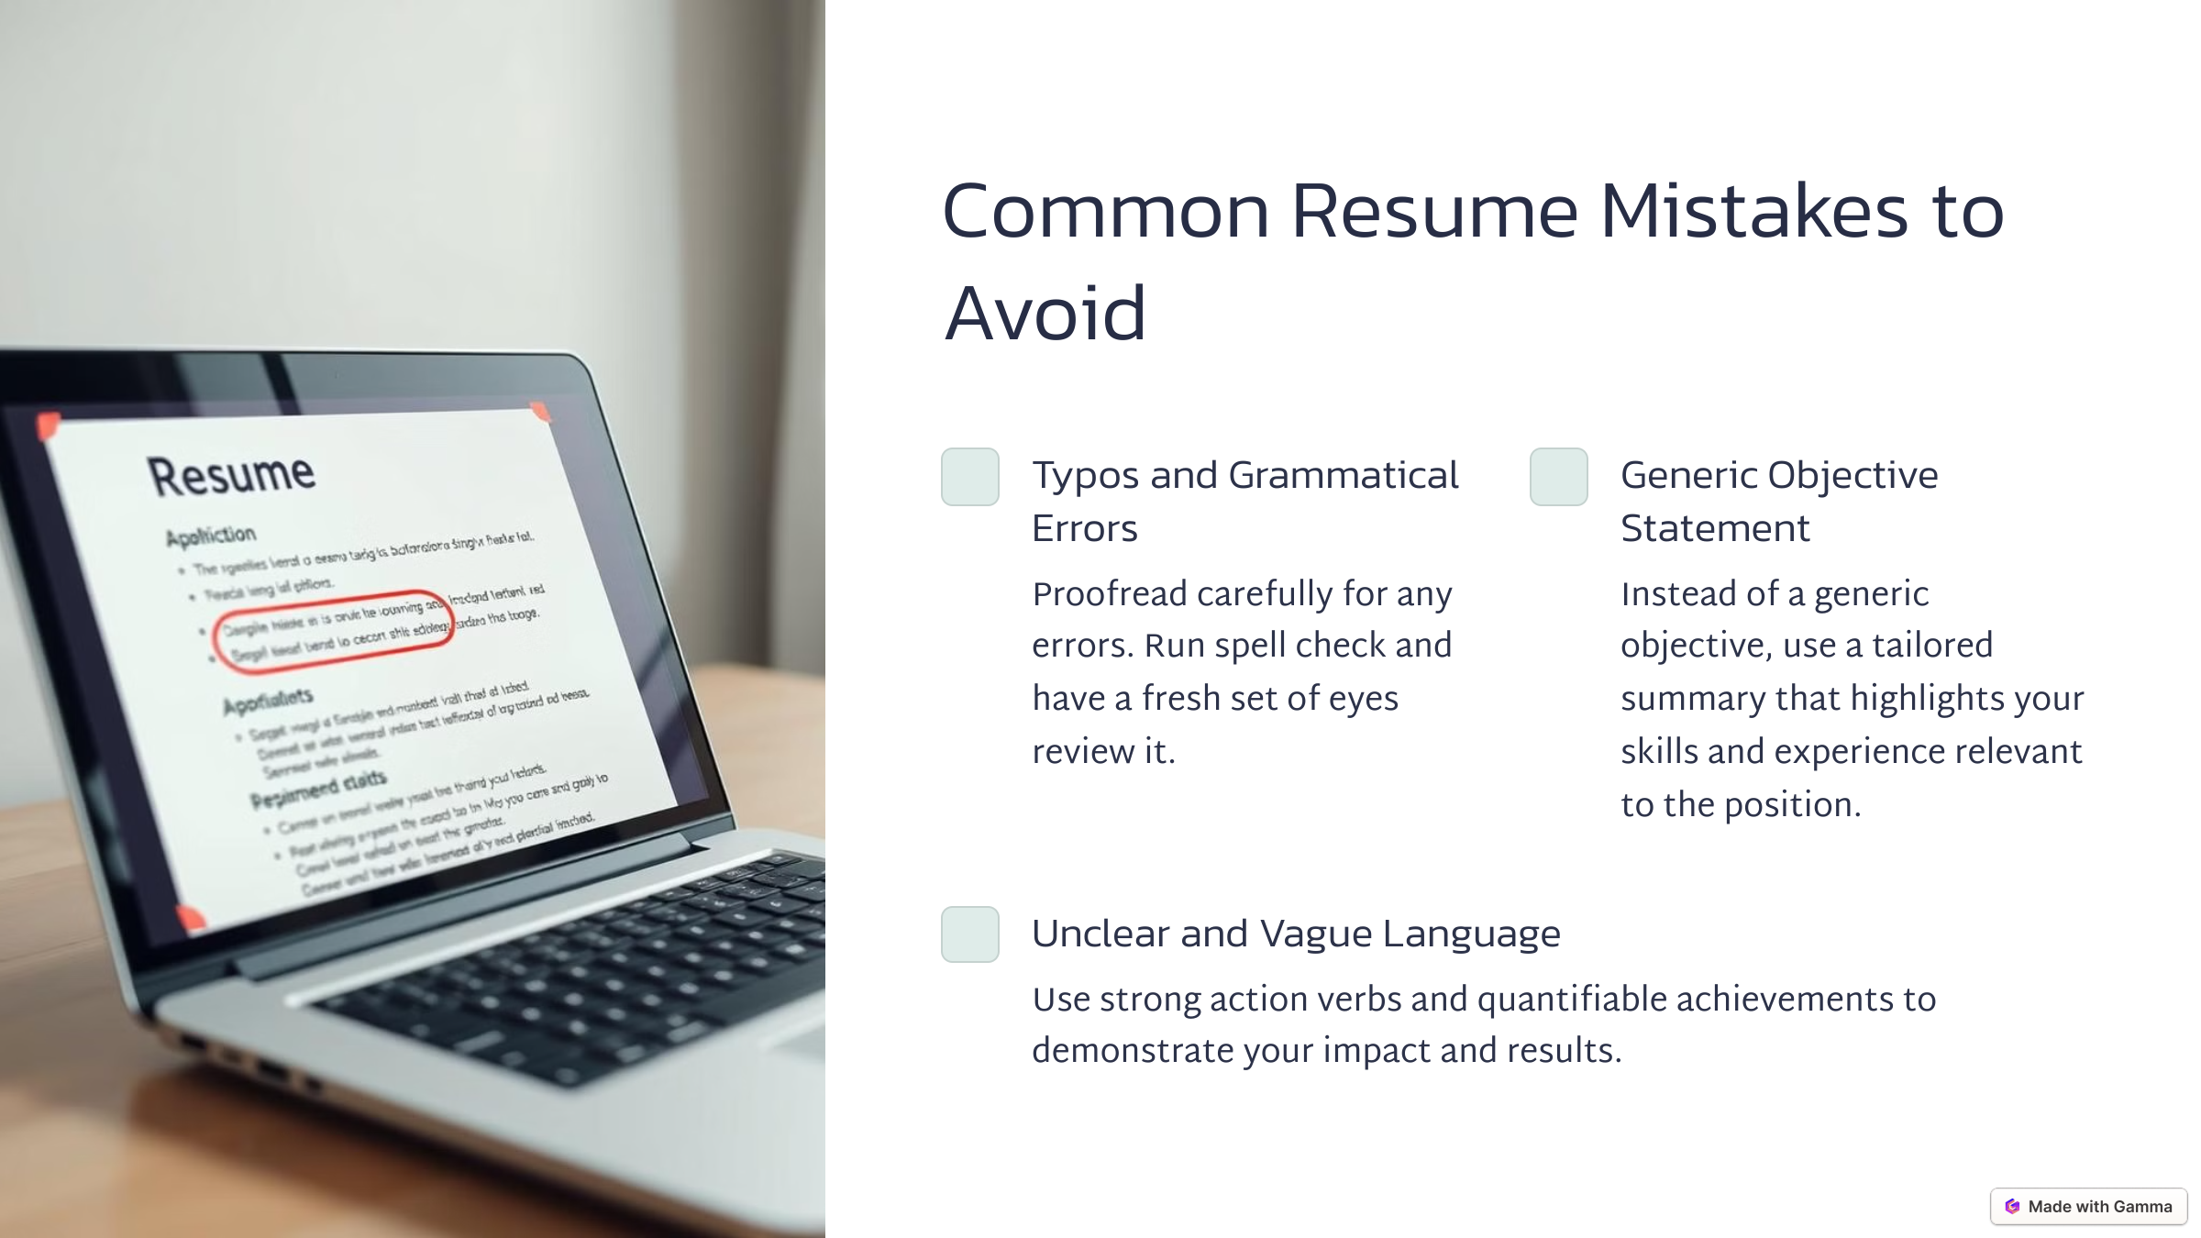
Common Résumé Mistakes to Avoid
Typos and Grammatical Errors
Proofread carefully for any errors. Run spell check and have a fresh set of eyes review it.
Generic Objective Statement
Instead of a generic objective, use a tailored summary that highlights your skills and experience relevant to the position.
Unclear and Vague Language
Use strong action verbs and quantifiable achievements to demonstrate your impact and results.

Slide 28

Tailoring Your Résumé for the Job
1
Research
Carefully read the job description and identify the key skills and qualifications
2
Match
Align your skills and experience with the requirements outlined in the job description
3
Highlight
Emphasize the aspects of your background that are most relevant to the specific job.
4
Customize
Adjust the language and content of your resume to reflect the needs of the particular employer.

Slide 29
Conclusion and Next Steps:
Crafting a strong resume is an essential step in the job search process. By following the guidelines and tips outlined in this presentation, you can create a compelling document that highlights your qualifications and helps you stand out from the competition. Now that you've learned the fundamentals of résumé writing, put your knowledge into practice! Review your existing résumé and make necessary improvements. Remember, a well-written résumé is a powerful tool that can open doors to exciting opportunities.

Slide 30
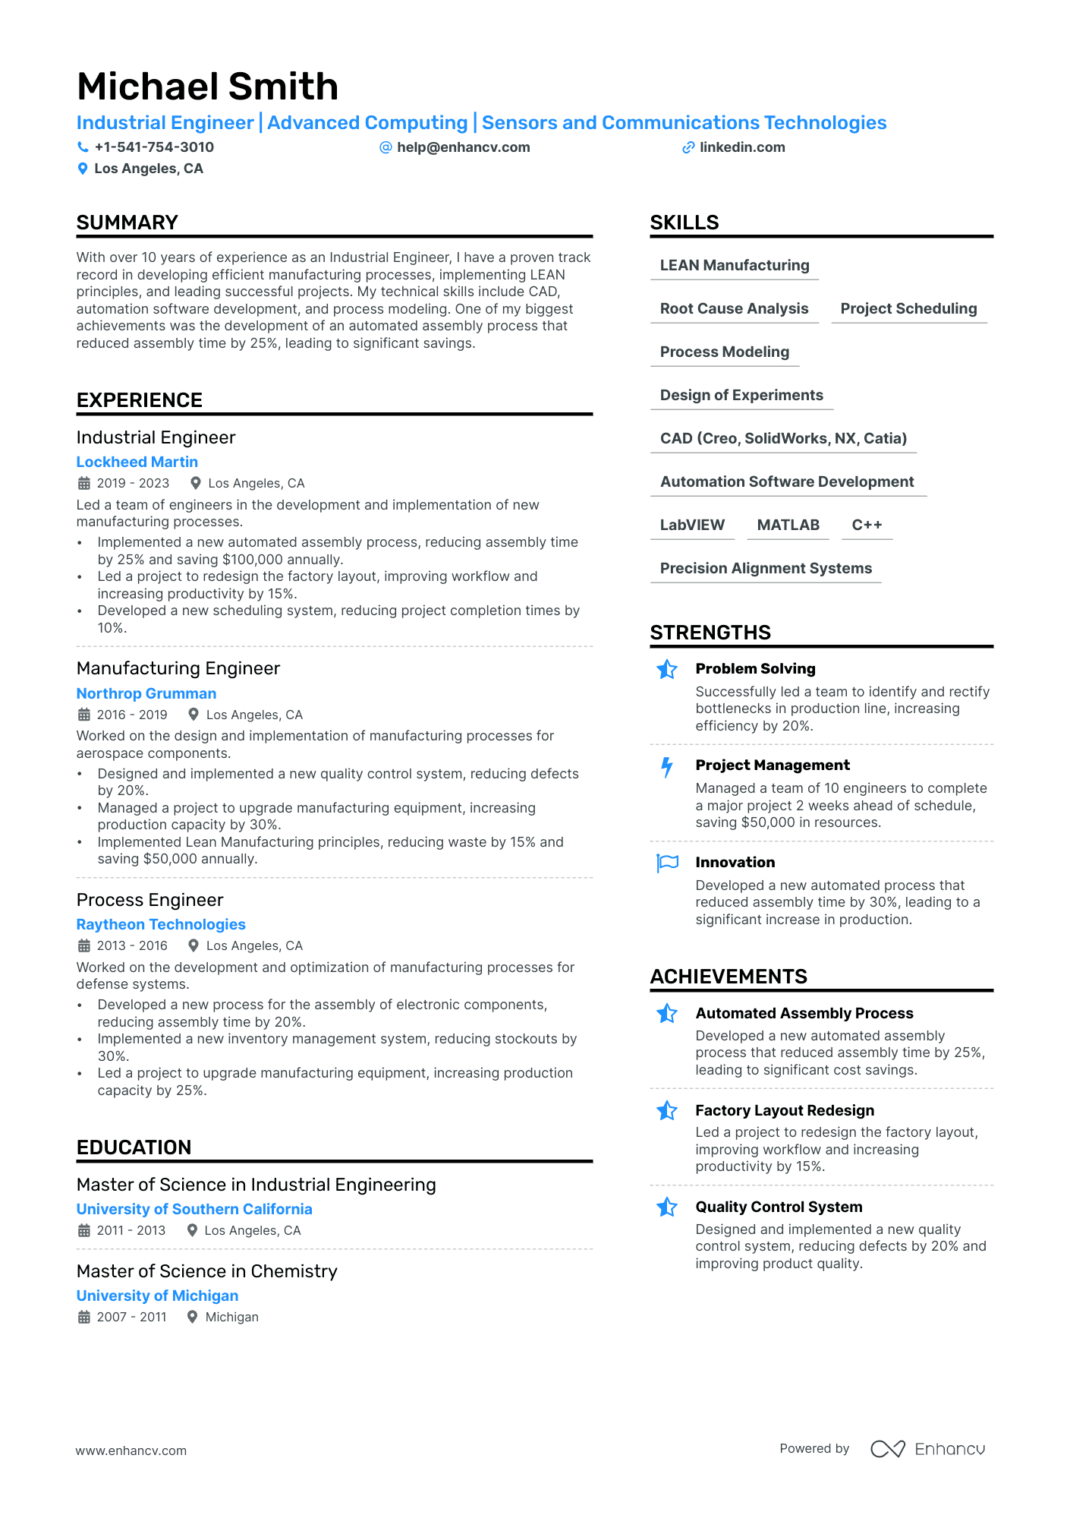
Sample Résumé :

Slide 31
Assessment of Job Application and Resume Writing: A Comprehensive Review for Success.
Question 1: What are the key components of an effective resume?
Question 2: How should I tailor my job application to a specific position?

Slide 32

Thank you for your time!
We hope you found this presentation informative and engaging

